Slide 1
Calsync
Presented By: Aaditya Rajput, Preet Patel, Tiwaloluwa Ojo

Slide 2
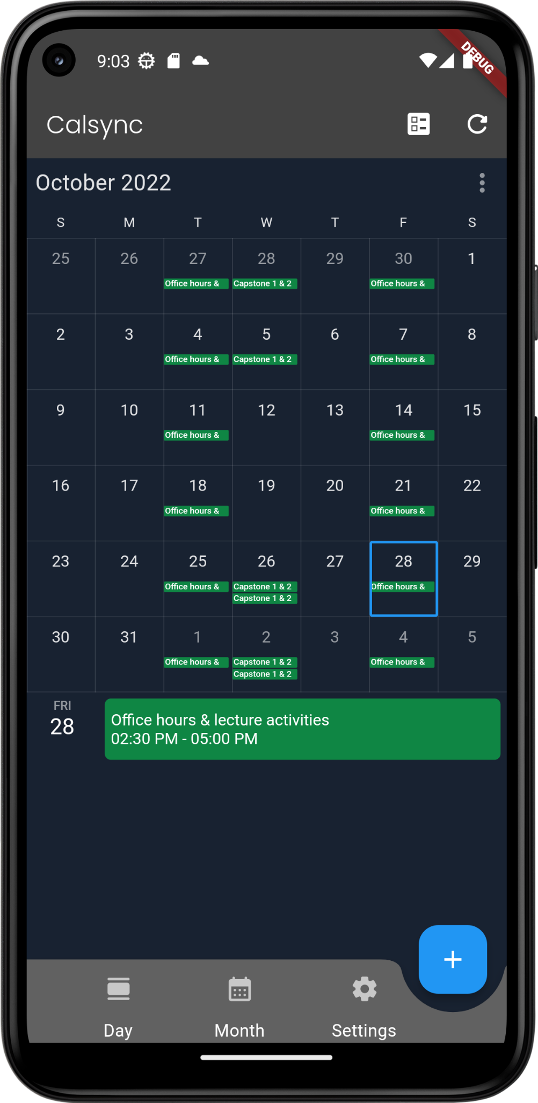
Introduction
Calsync is a mobile calendar application for managing and maintaining personal schedules
Our application allows the user to add, edit, delete events
The application also provides monthly, weekly, and daily views of the calendar to assist with planning in more detail
Calsync also provides the feature for synchronizing the app calendar with your google calendar

Slide 3
Demonstration

Slide 4
Thank you

